Slide 1

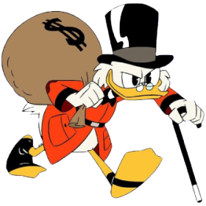
GREEDY ALGORITHMS
[These slides were created at https://www.slidescarnival.com]

Slide 2
MEMBERS
Lê Trịnh Thanh Thúy
19522325
Nguyễn Hoài Nam
18521126
Phạm Nguyễn Thanh Hà
19521458

Slide 3
TABLE OF CONTENTS
01
Introduction
02
Pattern Recognition
03
Pros & Cons
04
Applications

Slide 4
INTRODUCTION
1

Slide 5

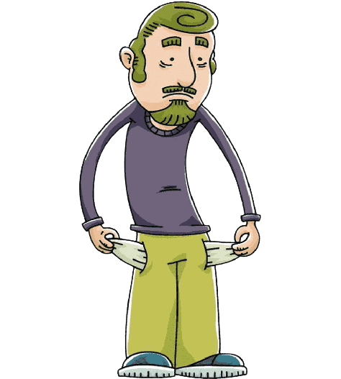

INTRODUCTION
Can you give me
55$ ?
25$
20$
10$
5$

Slide 6
INTRODUCTION
25$
20$
10$
5$
=
+
+
55$
25$
25$
5$

Slide 7

INTRODUCTION
What is Greedy Algorithm

Slide 8


START TIMER
TIME’S UP!
TIME LIMIT:
1 minute

Slide 9

INTRODUCTION
Greedy Algorithm – an algorithmic paradigm that follows the problem
solving approach of making the locally optimal choice at each stage
with the hope of finding a global optimum.

Slide 10
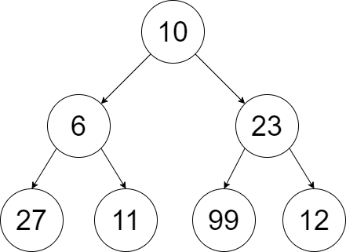
INTRODUCTION
10
Greedy algorithm
132
23
99

Slide 11
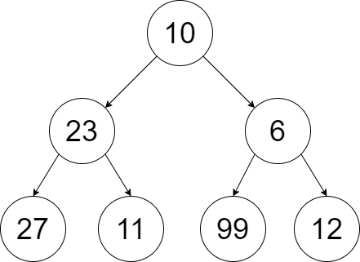
INTRODUCTION
Greedy algorithm
10
Actual largest path
10
60
115
23
6
27
99

Slide 12
INTRODUCTION
Can you give me
55$ ?
40$
25$
20$
10$
5$

Slide 13
INTRODUCTION
=
+
+
Greedy algorithm
40$
25$
10$
5$
=
+
Actual result
40$
20$
20$

Slide 14
INTRODUCTION
From which a solution is created
Candidate set
Which chooses the best candidate
to be added to the solution
In general, Greedy components have five components
Selection function
That is used to determine
if a candidate can be used to contribute to a solution
Fesibility function
Which assigns a value to a solution
or a partial solution
Objective function
Which will indicate
when we have discovered a complete solution
Solution function

Slide 15
INTRODUCTION
procedure Greedy;
begin
C := Candidate set;
S := Ø {Solution};
while (C Ø) and not Solution(S) do
begin
x <- Select(C)
C := C x;
if feasible(S U x) then S := S U x;
end;
if Solution(S) then return S;
end;
Pseudocode

Slide 16
PATTERN RECOGNITION
2

Slide 17
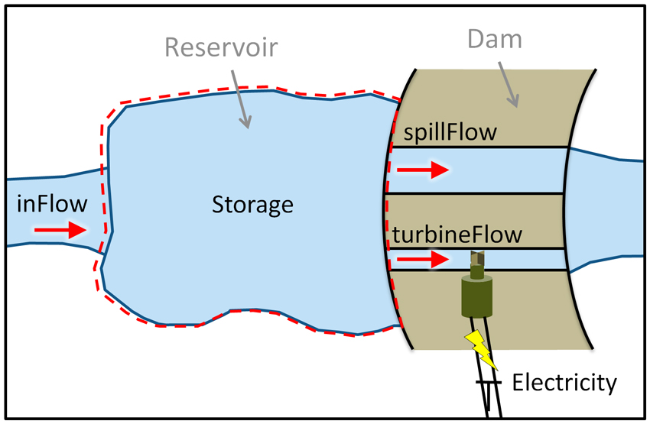

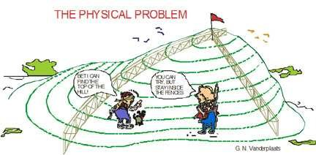
PATTERN RECOGNITION
Greedy algorithms are used for
problems

Slide 18
PATTERN RECOGNITION
Optimal substructure
Greedy choice property
A problem has an optimal substructure if an optimal solution to the entire problem contains the optimal solution to the sub-problems.
A global (overall) optimal solution can be reached by choosing the optimal choice at each step.
1
2
Greedy can be used to solve the problem if the problem has two properties:

Slide 19
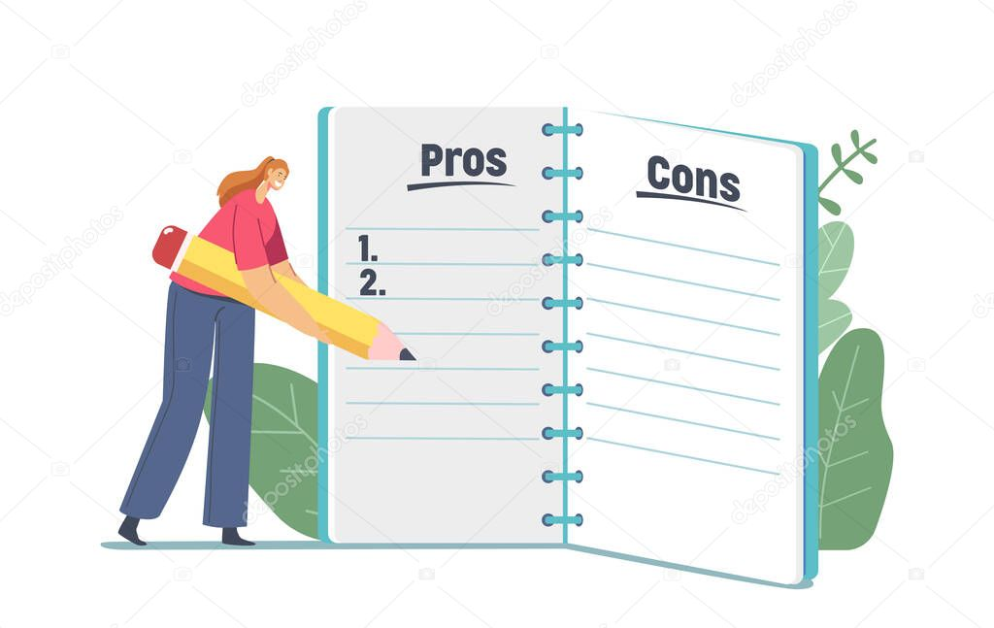
PROS & CONS
3

Slide 20
PROS & CONS
Pros
Cons
Finding solution is quite easy with a greedy algorithm for a problem
Analyzing the run time for greedy algorithms will generally be much easier than for other techniques
The local optimal solution may not always be global optimal

Slide 21
APPLICATIONS
4

Slide 22
APPLICATIONS
Activity-Selection Problem
Kruskal’s Algorithm
Huffman Coding
Sequencing Problem
Fractional Knapsack Problem
Examples in reality

Slide 23
ACTIVITY-SELECTION PROBLEM

Slide 24
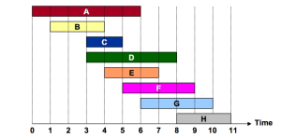
ACTIVITY SELECTION PROBLEM
Problem: Given a set of n activities, each having a start and finish time. Some of
these activities are overlapping. Select the maximum sized set of
non-overlapping activities.

Slide 25
ACTIVITY SELECTION PROBLEM
1
Sort the activities according to their finishing time
Problem steps
2
Select the first activity from the sorted array and print it
Do this following if the start time of this activity is greater than
3
or equal to the finish time of the previously selected activity
then select this activity and print it

Slide 26
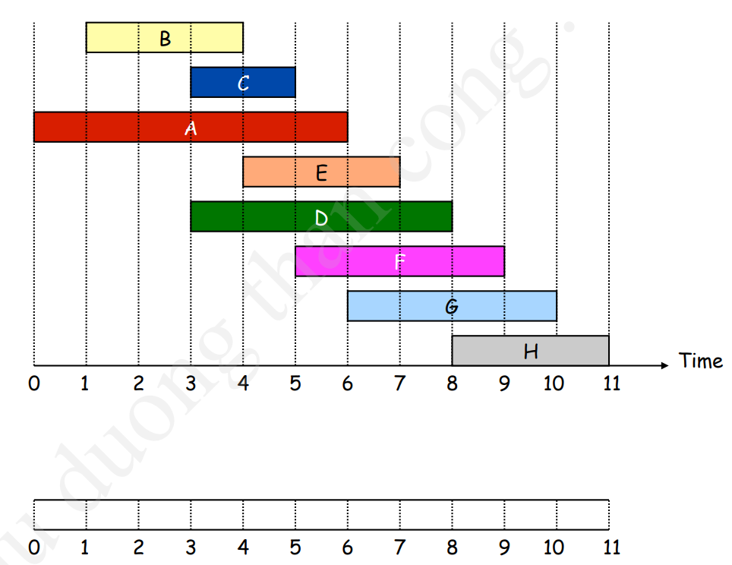
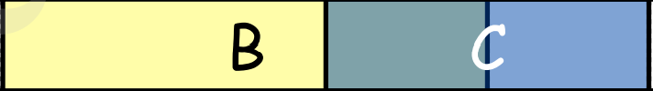

ACTIVITY SELECTION PROBLEM

Slide 27
KRUSKAL’S ALGORITHM

Slide 28
KRUSKAL’S ALGORITHM
B
10
3
A
C
6
8
4
5
4
H
3
Problem:
Consider an undirected, weight graph
G
4
D
2
3
F
E
1
3

Slide 29
KRUSKAL’S ALGORITHM
1
Sort all the graph edges in order of their weights
Problem steps
Start adding edges to the MST form the edge with the
2
smallest weight until the edge of the largest weight
3
Only add edges which doesn’t from a cycle, edges which connect
only disconnected components

Slide 30


KRUSKAL’S ALGORITHM
Edge | Weight
(D,E) | 1
(D,F) | 2
(E,F) | 3
(C,D) | 3
(F,G) | 3
(C,B) | 3
(H,C) | 4
(H,E) | 4
(H,B) | 4
(H,G) | 4
(A,G) | 5
(D,B) | 6
(A,H) | 8
(A,B) | 10
B
B
10
10
3
3
A
A
C
C
6
6
8
8
4
4
5
H
H
3
4
3
4
G
G
D
4
D
4
2
2
3
3
1
F
1
F
E
E
3
3
not considered

Slide 31
HUFFMAN CODING

Slide 32
HUFFMAN CODING
Problem: Giving a set of characters and their frequencies
Find a set of binary codewords that minimize the average length of the characters
Character | Frequency
A | 0011
NEWSPACE | 0
E | 110

Slide 33
HUFFMAN CODING
Character | Code | Frequency | Total bits
A | 0000 | 5 | 20
B | 0001 | 9 | 36
C | 0010 | 12 | 48
D | 0011 | 13 | 52
E | 1111 | 16 | 64
F | 1100 | 45 | 180
Total Bits Used: 400

Slide 34
HUFFMAN CODING
Character | Frequency
A | 5
B | 9
C | 12
D | 13
E | 16
F | 45
Character | Frequency
A | 1100
B | 1101
C | 100
D | 101
E | 111
F | 0
100
1
0
F
55
1
0
30
25
0
1
0
1
14
E
0
Total Bits Used: 224
C
D
1
A
B

Slide 35
JOB SEQUENCING PROBLEM

Slide 36
JOB SEQUENCING PROBLEM
Problem: Given n tasks. Each task Ti has deadline time di > 0 and profit
Pi > 0.
If task Ti completed on or before deadline time di then return profit Pi, otherwise no profit.
Execute tasks such that:
1) Every task ready to execute
2) One task at a time
3) Every task required 1 unit time for execute
So that total profit must be maximum

Slide 37
JOB SEQUENCING PROBLEM
Greedy Approach
1
Sort all tasks in decreasing order
2
Initialize the result sequence as first task in sorted tasks
3
Do following for remainning n-1 tasks
If the current task can fit in the current result sequence without missing the deadline, add current job to the result, else ignore the current job

Slide 38
JOB SEQUENCING PROBLEM
Tasks | A | B | C | D | E
Deadlines | 2 | 1 | 2 | 1 | 3
Profits | 100 | 19 | 27 | 25 | 15
After sorted
Tasks | A | C | D | B | E
Deadlines | 2 | 2 | 1 | 1 | 3
Profits | 100 | 27 | 25 | 19 | 15

Slide 39
JOB SEQUENCING PROBLEM
Tasks | A | C | D | B | E
Deadlines | 2 | 2 | 1 | 1 | 3
Profits | 100 | 27 | 25 | 19 | 15
 |  | E
Gantt chart:
D
 | A
0 1 2 3

Slide 40
FRACTIONAL KNAPSACK PROBLEM

Slide 41
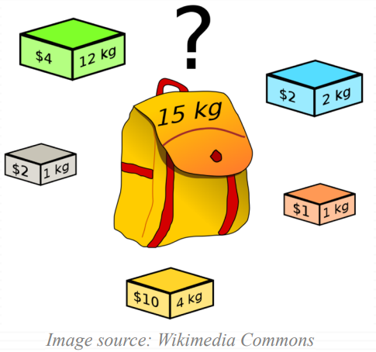
KNAPSACK PROBLEM
Problem:
Each item i has:
weight wi
value vi
A thief has a knapsack of weight capacity w
Which items to choose to maximize the value of the items in the knapsack?

Slide 42
KNAPSACK PROBLEM: Two versions
The 0-1 Knapsack Problem:
Each item is discrete
Each item is chosen as a whole or not chosen
Examples: TV, laptop, gold bricks,…
The Fractional Knapsack Problem:
Can choose fractional part of its item
If item i has weight wi, we can choose any amount <= wi
Examples: silver dusts, rice,…

Slide 43
FRACTIONAL KNAPSACK PROBLEM
Greedy Approach
1
Calculate the ratio (value/weight) for each item
2
Sort the items based on the ratio above
3
Take the item with highest ratio and add another one until we can’t add the next item
4
At the end, add the next item as much (fraction) as we can

Slide 44
FRACTIONAL KNAPSACK PROBLEM
Greedy Approach
20kg
$120
20kg
$100
10kg
$60
w1 = 10kg
v1 = $60
v1/w1 = 6
w2 = 20kg
v2 = $100
v2/w2 = 5
w3 = 30kg
v3= $120
v3/w3 = 4
capacity = 50kg
Total = $240

Slide 45
FRACTIONAL KNAPSACK PROBLEM
Pseudocode:
Fractional Knapsack (Array w, Array v, int M)
for i <- 1 to size(v)
calculate cost[i] <- v[i] / w[i]
Sort-Descending (cost)
i <- 1
while (i <= size(v))
if w[i] <= M
M <- M - w[i]
total <- total + v[i]
if w[i] > M
total <- total + v[i] * (M / w[i])
break
end
Time complexity:
Depend on sort algorithm
If using a simple sort algorithm
The complexity is O(n^2)
If using quick sort or merge sort
The complexity is O(nlogn)

Slide 46
0-1 KNAPSACK PROBLEM
Can we use the same greedy algorithm?
20kg
$100
10kg
$60
w1 = 10kg
V1 = $60
v1/w1 = 6
w2 = 20kg
v2 = $100
v2/w2 = 5
w3 = 30kg
v3 = $120
v3/w3 = 4
capacity = 50kg
Total = $160

Slide 47
0-1 KNAPSACK PROBLEM
Both of two approaches cannot be obtained using Greedy algorithm => Solved by Dynamic programming
20kg
$100
Take largest value first
30kg
$120
w1 = 10kg
v1 = $60
v1/w1 = 6
w2 = 20kg
v2 = $100
v2/w2 = 5
w3 = 30kg
v3 = $120
v3/w3 = 4
capacity = 50kg
Total = $220

Slide 48
0-1 KNAPSACK PROBLEM
Pseudocode:
0-1 Knapsack (Array w, Array v, int M)
total <- 0
Sort weight(value) in descending order
while i < n do
if w[i] <= M then
total += v[i];
M -= w[i];
end
i++
end
Time complexity:
Depend on sort algorithm
If using a simple sort algorithm
The complexity is O(n)

Slide 49
DYNAMIC vs GREEDY
 | Dynamic Programming | Greedy Strategy
Similar | Both requires optimal substructure
Different | Finds solution bottom – up Makes choices knowing optimal solutions efficiency handles subproblem interaction EX: 0 – 1 Knapsack | Finds solution top – down Cannot handle overlapping subproblems EX: Fractional Knapsack

Slide 50
EXAMPLES IN REALITY
Sorting files on magnetic tape (not RAM)
Blue Water Super Computer
IP routing
Sudoku
Networking protocols
Vehicle routing
Making schedule / time table
…

Slide 51
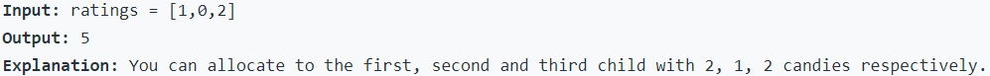
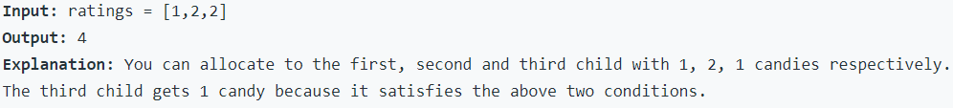
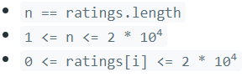
HOMEWORK
There are n children standing in a line. Each child is assigned a rating value given in the integer array ratings .
You are giving candies to these children subjected to the following requirements:
Each child must have at least one candy.
Children with a higher rating get more candies than their neighbors.
Return the minimum number of candies you need to have to distribute the candies to the children.
Example 1:
Example 2:
Constraints:

Slide 52
THANK YOU SO MUCH!
😉

